Slide 1

Lecture 5:
DC & Transient Response

Slide 2
Outline
DC Response
Logic Levels and Noise Margins
Transient Response
RC Delay Models
Delay Estimation
5: DC and Transient Response

Slide 3
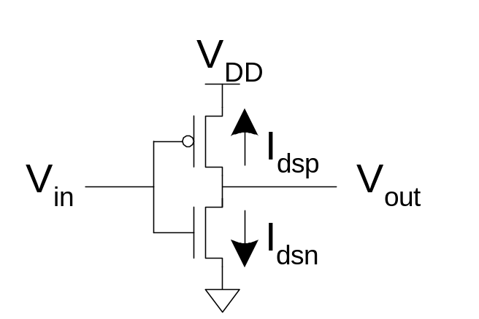
DC Response
DC Response: V_{out} vs. V_{in} for a gate
Ex: Inverter
  When V_{in} = 0 -> V_{out} = V_{DD}
  When V_{in} = V_{DD} -> V_{out} = 0
  In between, V_{out} depends on
  transistor size and current
  By KCL, must settle such that
  I_{dsn} = |I_{dsp}|
  We could solve equations
  But graphical solution gives more insight
5: DC and Transient Response

Slide 4
Transistor Operation
Current depends on region of transistor behavior
For what V_{in} and V_{out} are nMOS and pMOS in
  Cutoff?
  Linear?
  Saturation?
5: DC and Transient Response

Slide 5
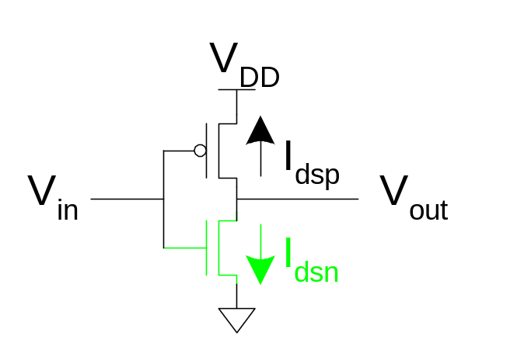
nMOS Operation
Cutoff | Linear | Saturated
V_{gsn} < V_{tn} V_{in} < V_{tn} | V_{gsn} > V_{tn} V_{in} > V_{tn} V_{dsn} < V_{gsn} – V_{tn} V_{out} < V_{in} - V_{tn} | V_{gsn} > V_{tn} V_{in} > V_{tn} V_{dsn} > V_{gsn} – V_{tn} V_{out} > V_{in} - V_{tn}
V_{gsn} = V_{in}
V_{dsn} = V_{out}
5: DC and Transient Response

Slide 6
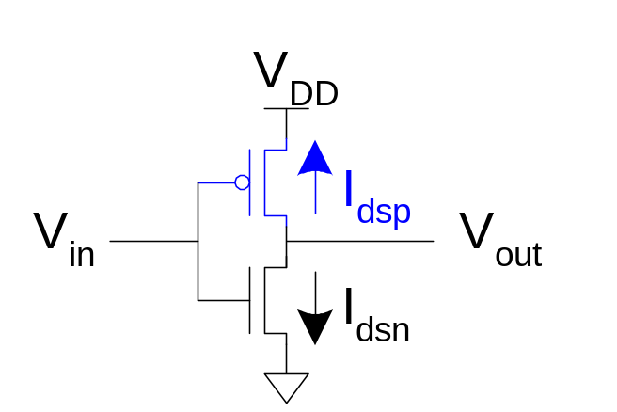
pMOS Operation
Cutoff | Linear | Saturated
V_{gsp} > V_{tp} V_{in} > V_{DD} + V_{tp} | V_{gsp} < V_{tp} V_{in} < V_{DD} + V_{tp} V_{dsp} > V_{gsp} – V_{tp} V_{out} > V_{in} - V_{tp} | V_{gsp} < V_{tp} V_{in} < V_{DD} + V_{tp} V_{dsp} < V_{gsp} – V_{tp} V_{out} < V_{in} - V_{tp}
V_{gsp} = V_{in} - V_{DD}
V_{dsp} = V_{out} - V_{DD}
V_{tp} < 0
5: DC and Transient Response

Slide 7
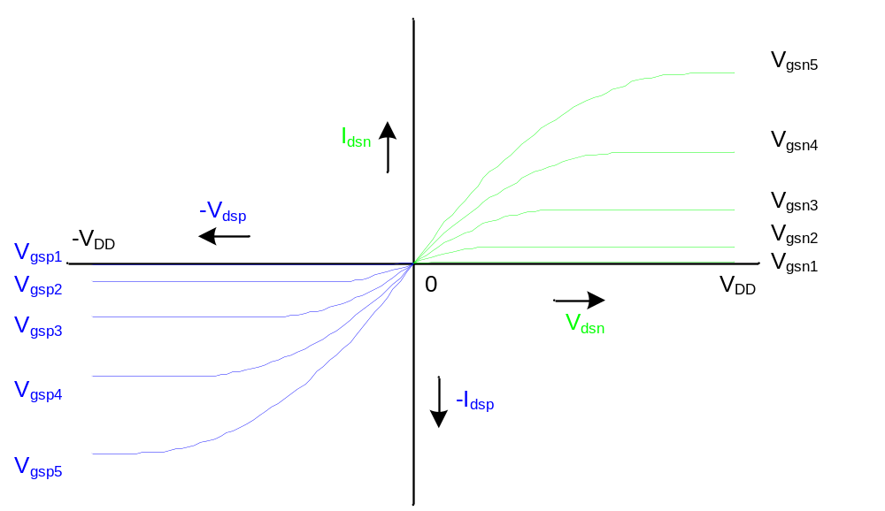
I-V Characteristics
Make pMOS is wider than nMOS such that β_{n} = β_{p}
5: DC and Transient Response

Slide 8
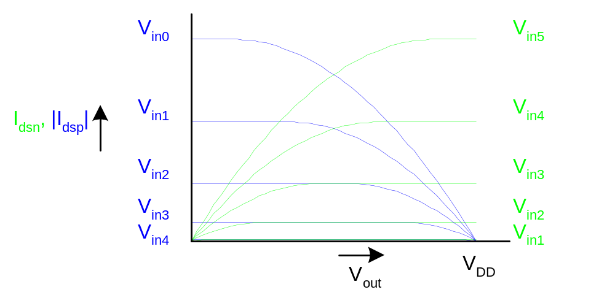
Current vs. V_{out}, V_{in}
5: DC and Transient Response

Slide 9
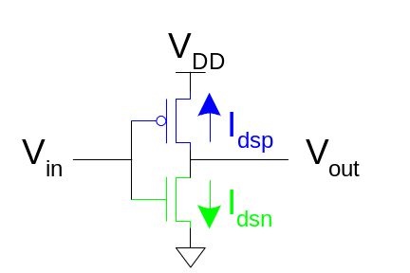
Load Line Analysis
For a given V_{in}:
  Plot I_{dsn}, I_{dsp} vs. V_{out}
  V_{out} must be where |currents| are equal in
5: DC and Transient Response

Slide 10
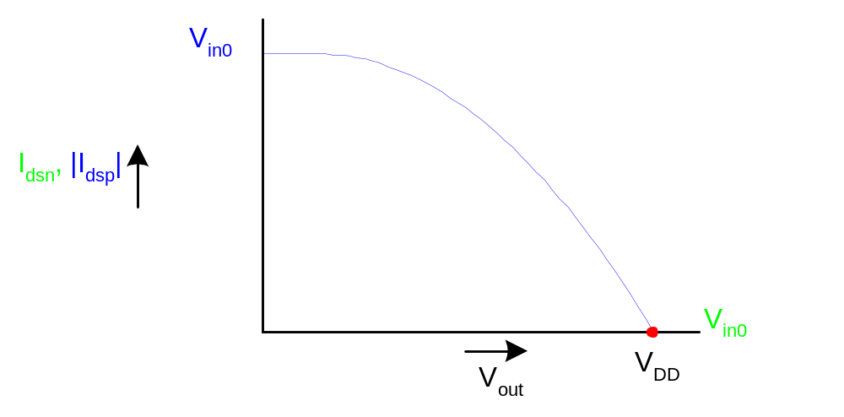
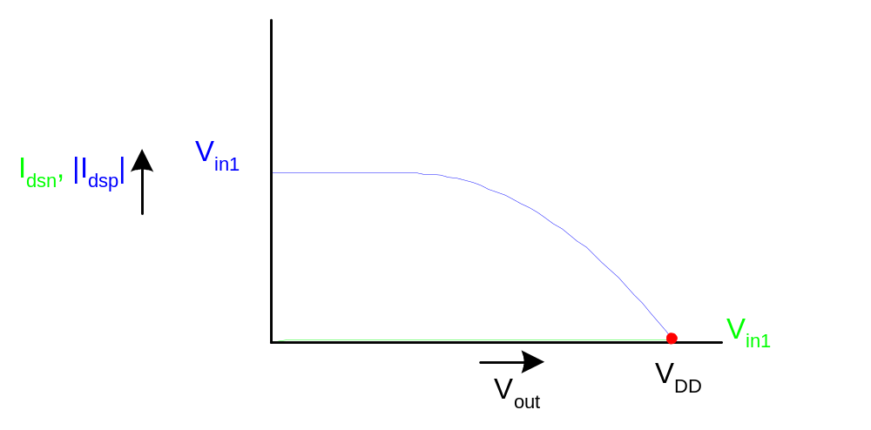
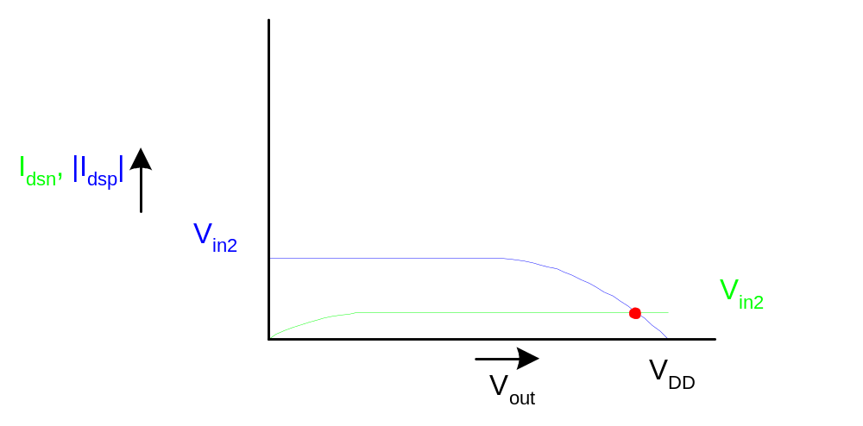
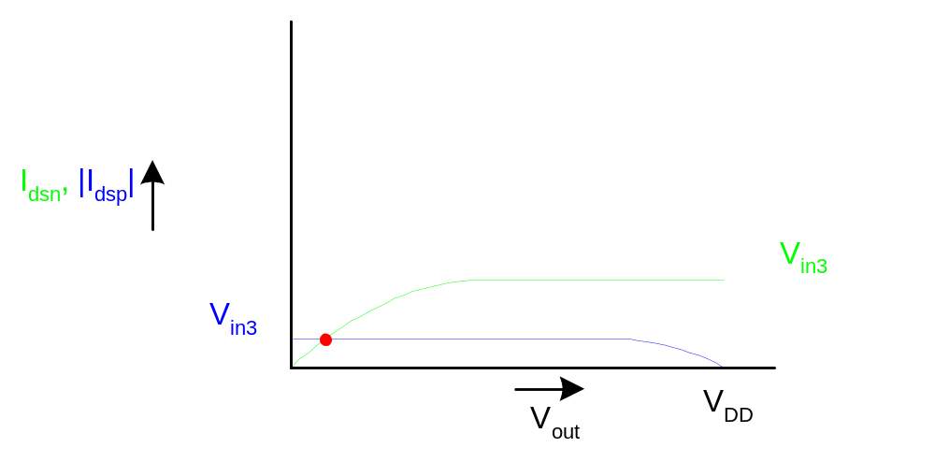
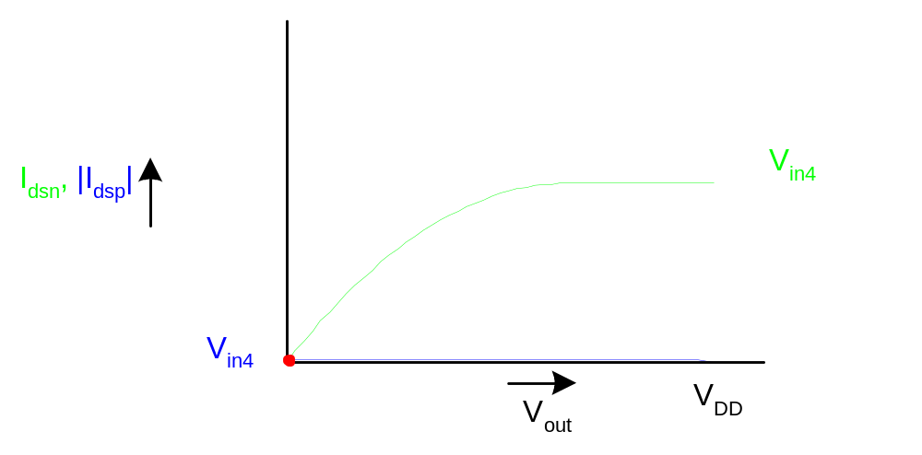
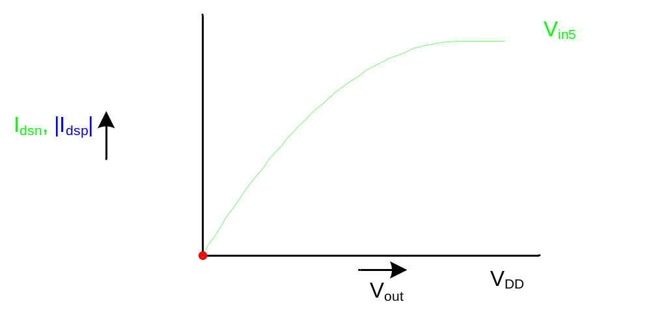
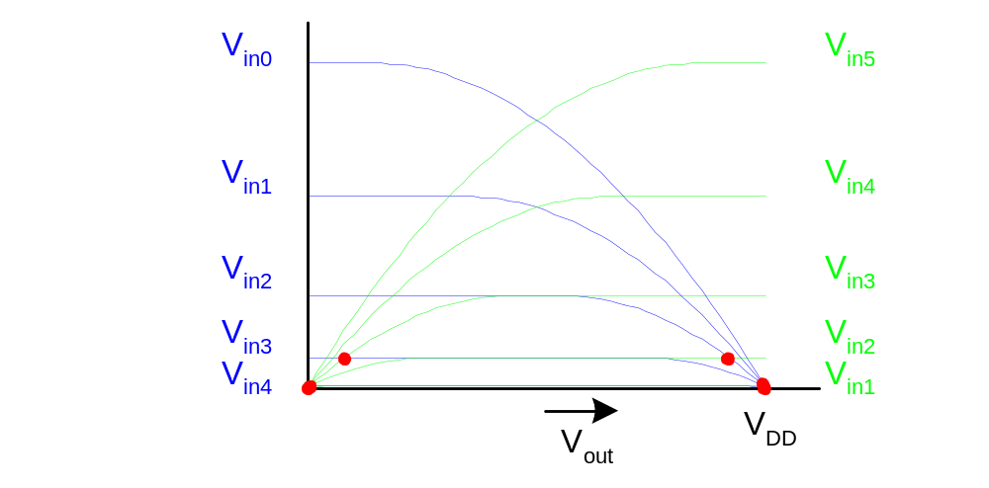
Load Line Analysis
V_{in} = 0
V_{in} = 0
0.2V_{DD}
V_{DD}
0.4V_{DD}
0.6V_{DD}
0.8V_{DD}
5: DC and Transient Response

Slide 11
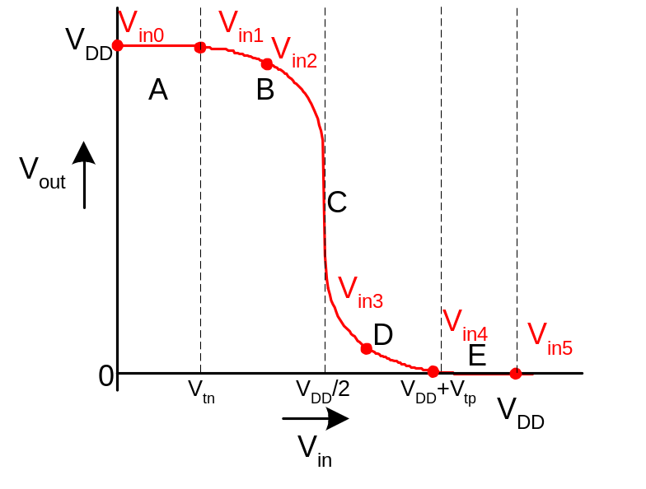
DC Transfer Curve
Transcribe points onto V_{in} vs. V_{out} plot
5: DC and Transient Response

Slide 12
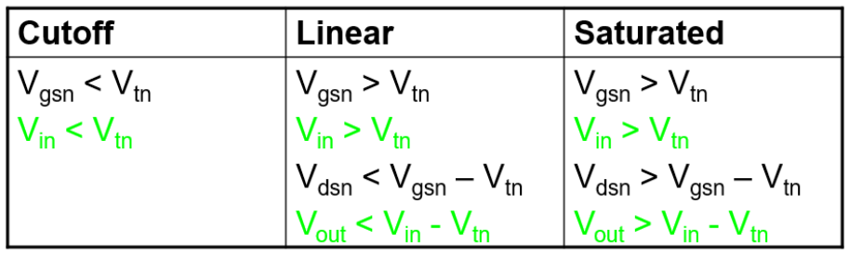
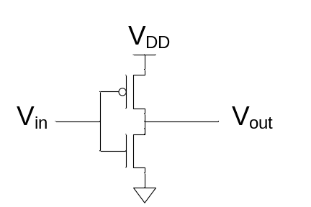
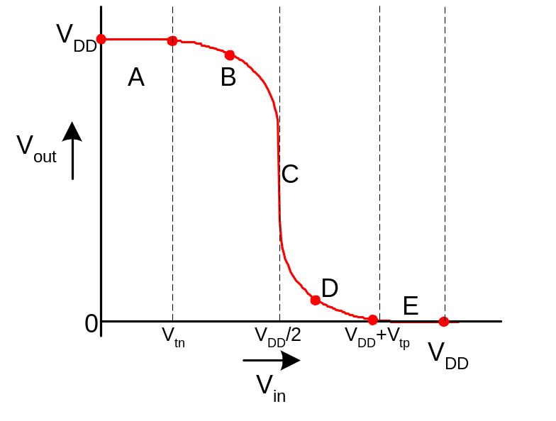
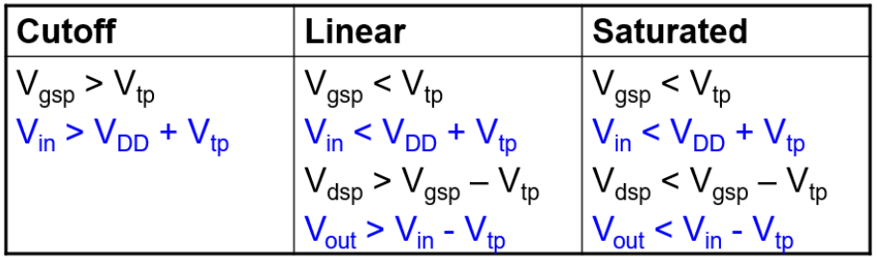
Operating Regions
Revisit transistor operating regions
Region | nMOS | pMOS
A | Cutoff | Linear
B | Saturation | Linear
C | Saturation | Saturation
D | Linear | Saturation
E | Linear | Cutoff
5: DC and Transient Response

Slide 13
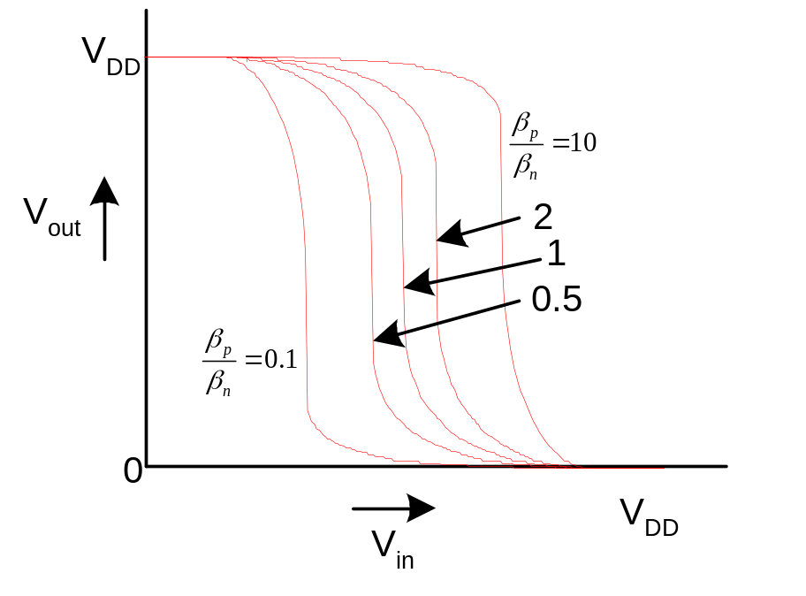
Beta Ratio
If β_{p} / β_{n} ≠ 1,
Called skewed gate
Other gates: collapse into equivalent inverter
5: DC and Transient Response

Slide 14
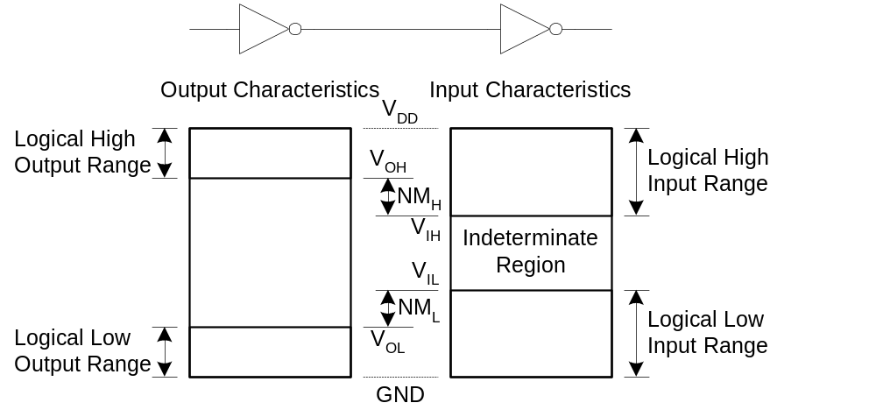
Noise Margins
How much noise can a gate input see before it does not recognize the input?
5: DC and Transient Response

Slide 15
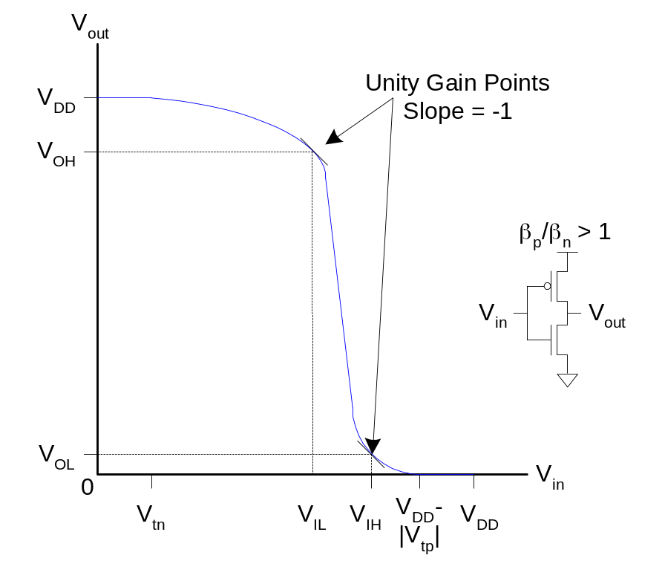
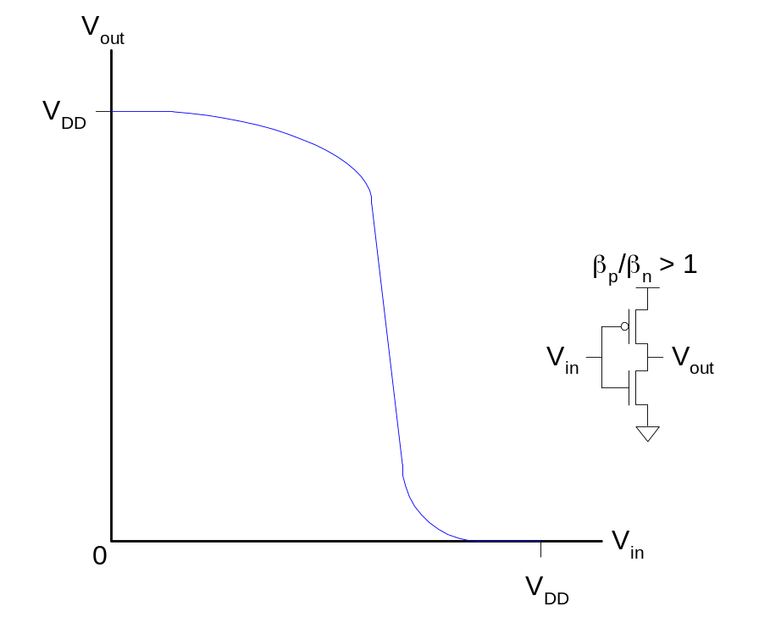
Logic Levels
To maximize noise margins, select logic levels at
  unity gain point of DC transfer characteristic
5: DC and Transient Response

Slide 16
Transient Response
DC analysis tells us V_{out} if V_{in} is constant
Transient analysis tells us V_{out}(t) if V_{in}(t) changes
  Requires solving differential equations
Input is usually considered to be a step or ramp
  From 0 to V_{DD} or vice versa
5: DC and Transient Response

Slide 17
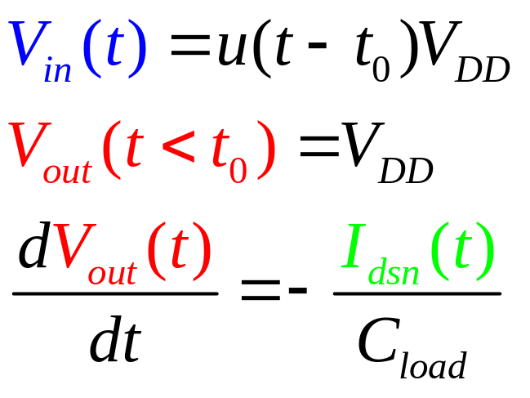
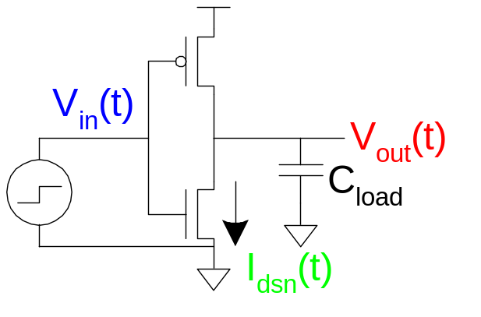
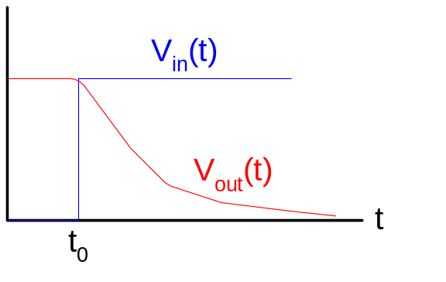
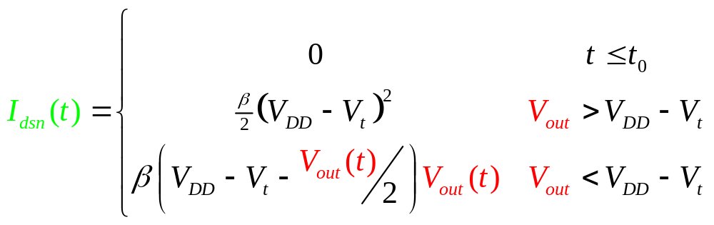
Inverter Step Response
Ex: find step response of inverter driving load cap
5: DC and Transient Response

Slide 18
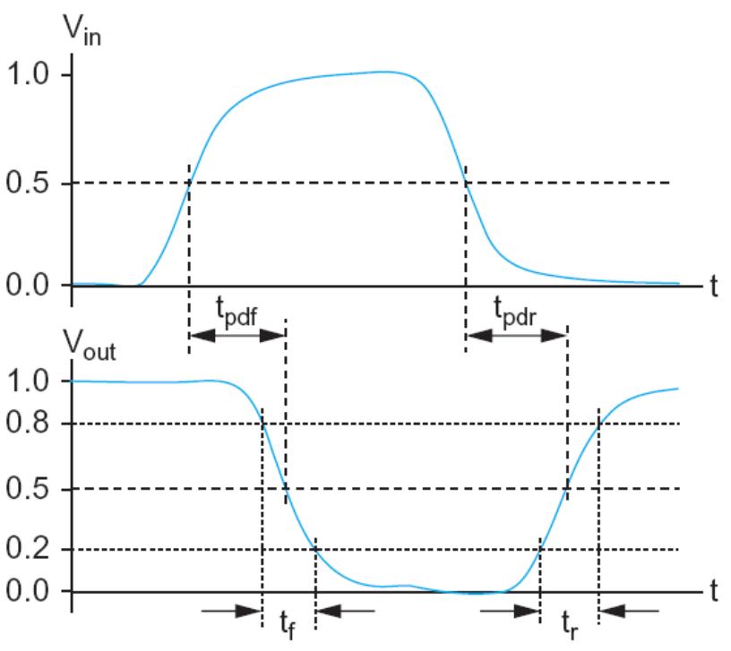
Delay Definitions
t_{pdr}: rising propagation delay
  From input to rising output crossing V_{DD}/2
t_{pdf}: falling propagation delay
  From input to falling output crossing V_{DD}/2
t_{pd}: average propagation delay
  t_{pd} = (t_{pdr} + t_{pdf})/2
t_{r}: rise time
  From output crossing 0.2 V_{DD} to 0.8 V_{DD}
t_{f}: fall time
  From output crossing 0.8 V_{DD} to 0.2 V_{DD}
5: DC and Transient Response

Slide 19
Delay Definitions
t_{cdr}: rising contamination delay
  From input to rising output crossing V_{DD}/2
t_{cdf}: falling contamination delay
  From input to falling output crossing V_{DD}/2
t_{cd}: average contamination delay
  t_{pd} = (t_{cdr} + t_{cdf})/2
5: DC and Transient Response

Slide 20
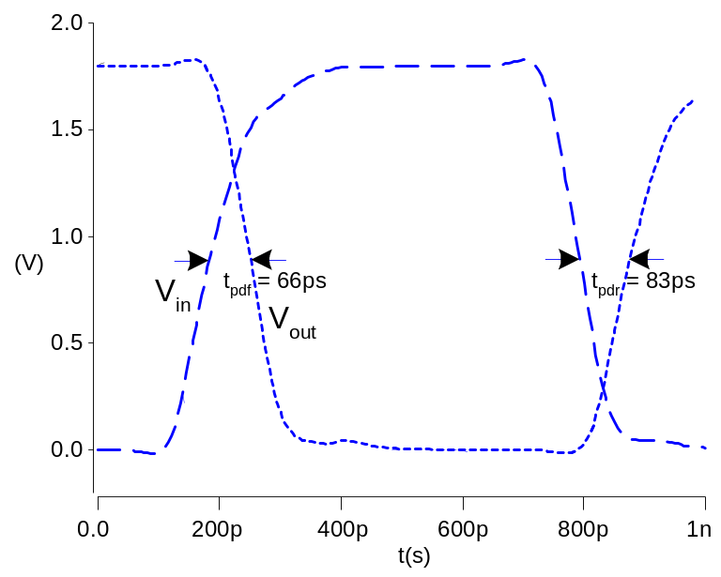
Simulated Inverter Delay
Solving differential equations by hand is too hard
SPICE simulator solves the equations numerically
  Uses more accurate I-V models too!
But simulations take time to write, may hide insight
5: DC and Transient Response

Slide 21
Delay Estimation
We would like to be able to easily estimate delay
  Not as accurate as simulation
  But easier to ask “What if?”
The step response usually looks like a 1st order RC response with a decaying exponential.
Use RC delay models to estimate delay
  C = total capacitance on output node
  Use effective resistance R
  So that t_{pd} = RC
Characterize transistors by finding their effective R
  Depends on average current as gate switches
5: DC and Transient Response

Slide 22
Effective Resistance
Shockley models have limited value
  Not accurate enough for modern transistors
  Too complicated for much hand analysis
Simplification: treat transistor as resistor
  Replace I_{ds}(V_{ds}, V_{gs}) with effective resistance R
    I_{ds} = V_{ds}/R
  R averaged across switching of digital gate
Too inaccurate to predict current at any given time
  But good enough to predict RC delay
5: DC and Transient Response

Slide 23
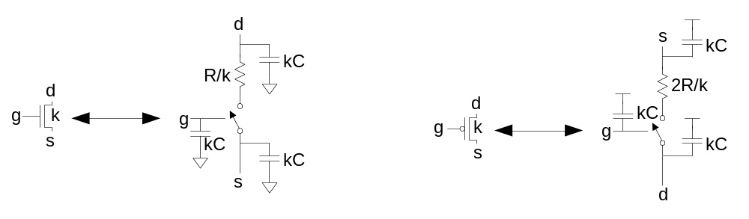
RC Delay Model
Use equivalent circuits for MOS transistors
  Ideal switch + capacitance and ON resistance
  Unit nMOS has resistance R, capacitance C
  Unit pMOS has resistance 2R, capacitance C
Capacitance proportional to width
Resistance inversely proportional to width
5: DC and Transient Response

Slide 24
RC Values
Capacitance
  C = C_{g} = C_{s} = C_{d} = 2 fF/μm of gate width in 0.6 μm
  Gradually decline to 1 fF/μm in 65 nm
Resistance
  R ≈ 10 KΩ•μm in 0.6 μm process
  Improves with shorter channel lengths
  1.25 KΩ•μm in 65 nm process
Unit transistors
  May refer to minimum contacted device (4/2 λ)
  Or maybe 1 μm wide device
  Doesn’t matter as long as you are consistent
5: DC and Transient Response

Slide 25
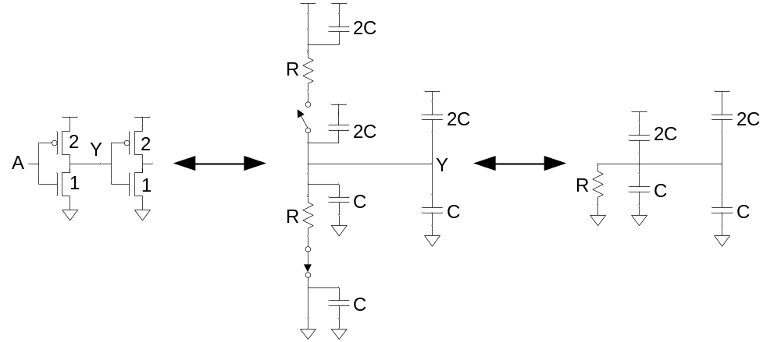
Inverter Delay Estimate
Estimate the delay of a fanout-of-1 inverter
d = 6RC
5: DC and Transient Response

Slide 26
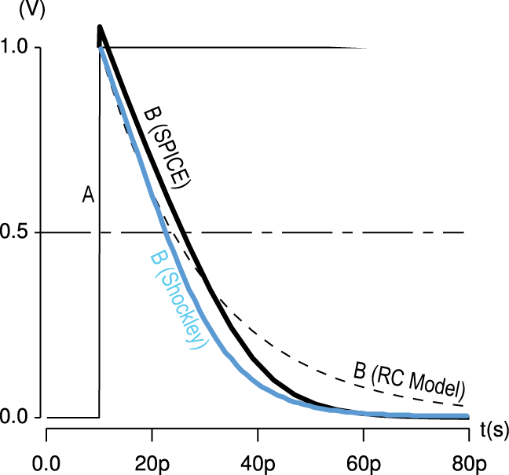
Delay Model Comparison
5: DC and Transient Response

Slide 27
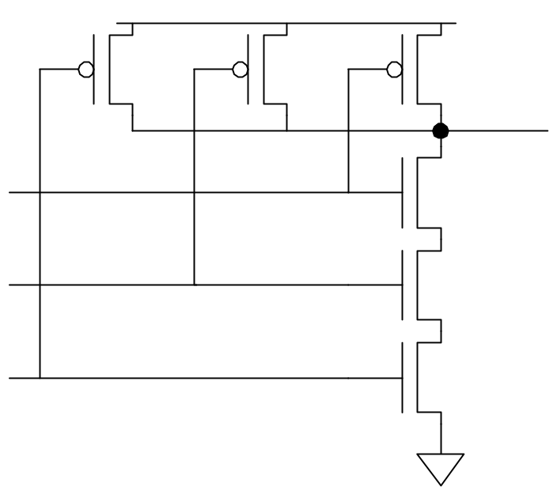
Example: 3-input NAND
Sketch a 3-input NAND with transistor widths chosen to achieve effective rise and fall resistances equal to a unit inverter (R).
2
2
2
3
3
3
5: DC and Transient Response

Slide 28
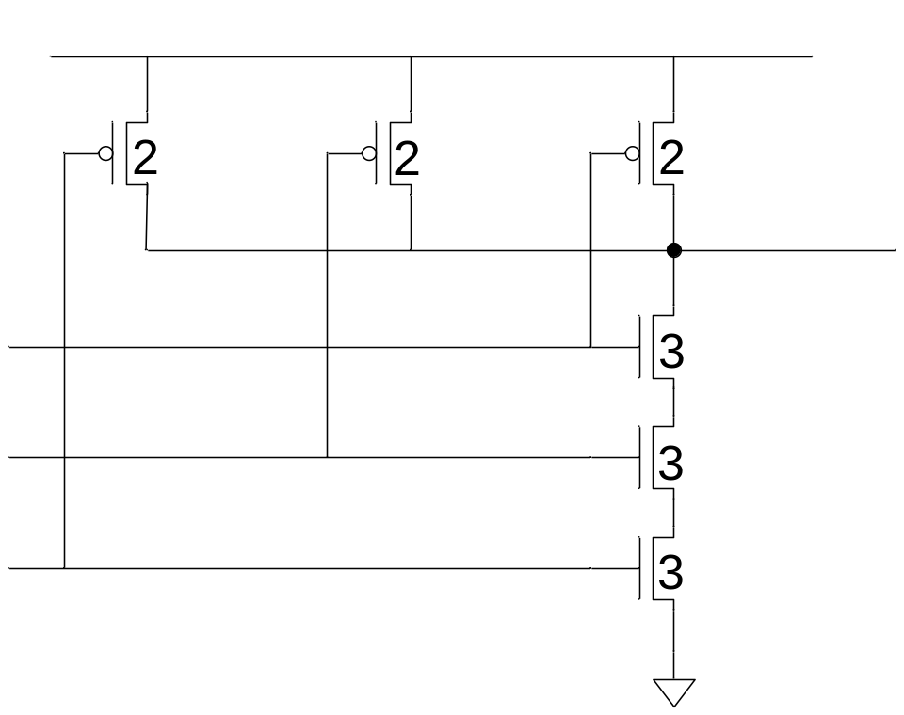
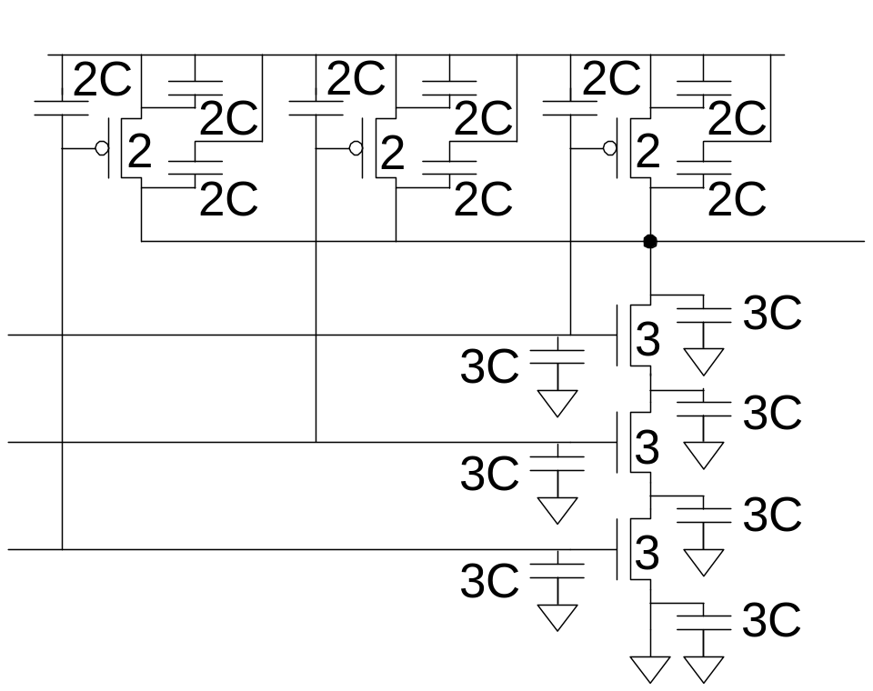
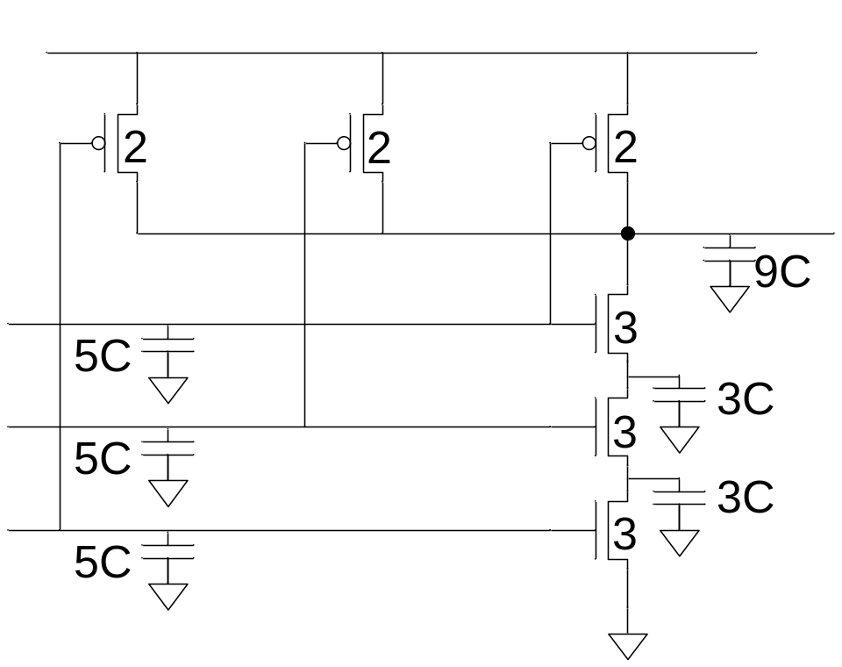
3-input NAND Caps
Annotate the 3-input NAND gate with gate and diffusion capacitance.
5: DC and Transient Response

Slide 29
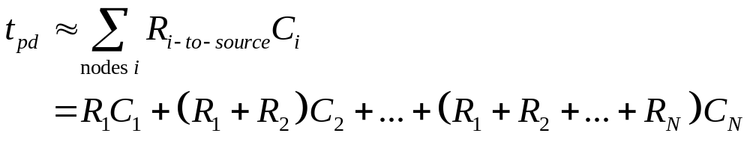
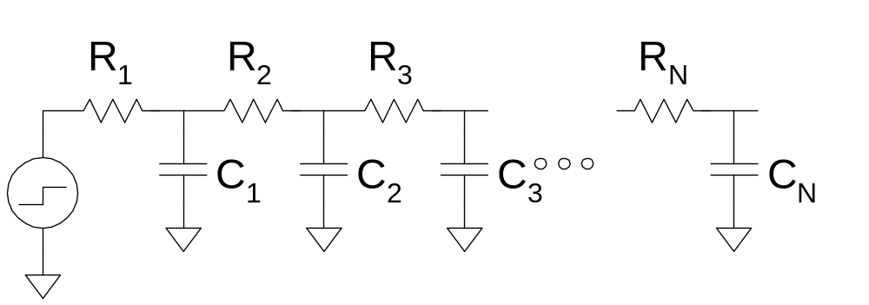
Elmore Delay
ON transistors look like resistors
Pullup or pulldown network modeled as RC ladder
Elmore delay of RC ladder
5: DC and Transient Response

Slide 30
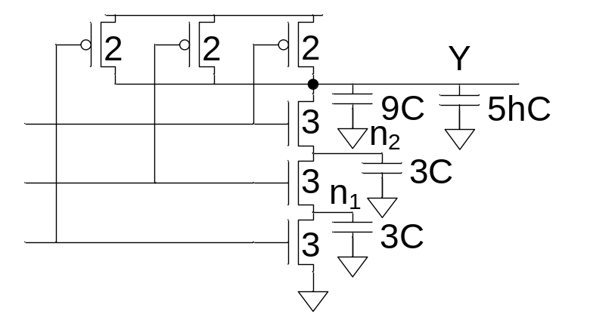
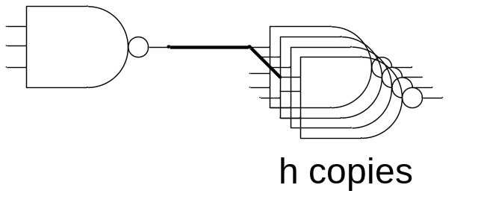
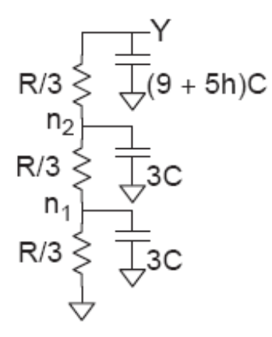
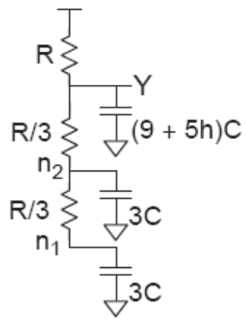
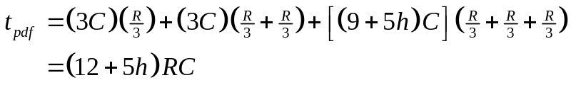

Example: 3-input NAND
Estimate worst-case rising and falling delay of 3-input NAND driving h identical gates.
5: DC and Transient Response

Slide 31
Delay Components
Delay has two parts
  Parasitic delay
    9 or 12 RC
    Independent of load
  Effort delay
    5h RC
    Proportional to load capacitance
5: DC and Transient Response

Slide 32
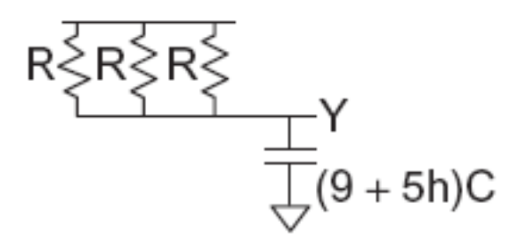
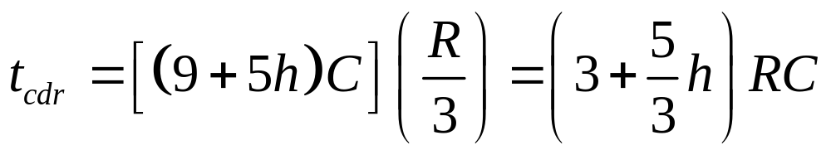
Contamination Delay
Best-case (contamination) delay can be substantially less than propagation delay.
Ex: If all three inputs fall simultaneously
5: DC and Transient Response

Slide 33
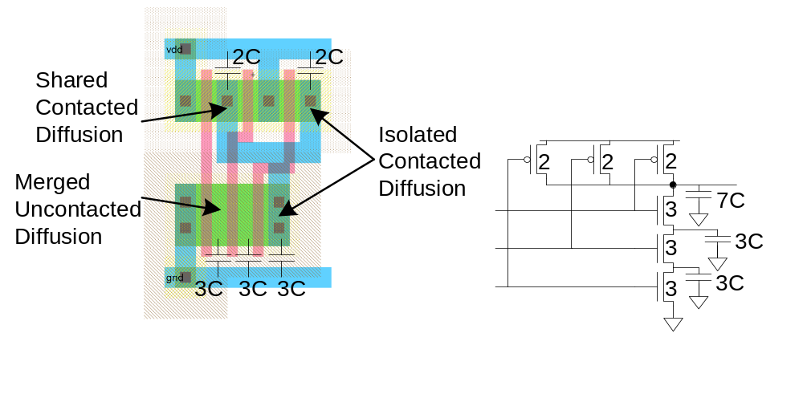
Diffusion Capacitance
We assumed contacted diffusion on every s / d.
Good layout minimizes diffusion area
Ex: NAND3 layout shares one diffusion contact
  Reduces output capacitance by 2C
  Merged uncontacted diffusion might help too
5: DC and Transient Response

Slide 34
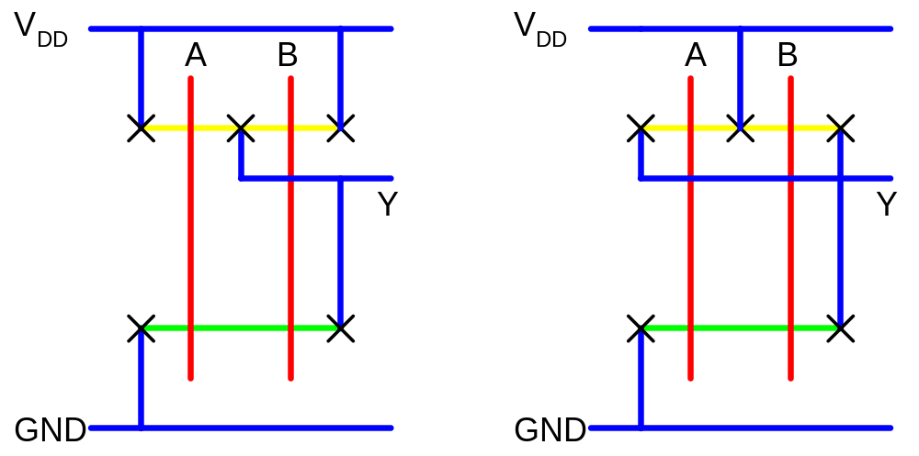
Layout Comparison
Which layout is better?
5: DC and Transient Response

